Slide 1

LIT Thurles Water & Energy Monitoring System

Slide 2
Introduction
Project Team : Kevin Doherty, Paul Mackey & Nicholas O’ Donnell Supervisor: Dr. Liam Noonan
We were tasked in 3rd year to develop a system to record water and electricity usage for the Thurles Campus
This system would be of use to the campus community to assist in identifying if changes in behaviour would reduce actual usage

Slide 3
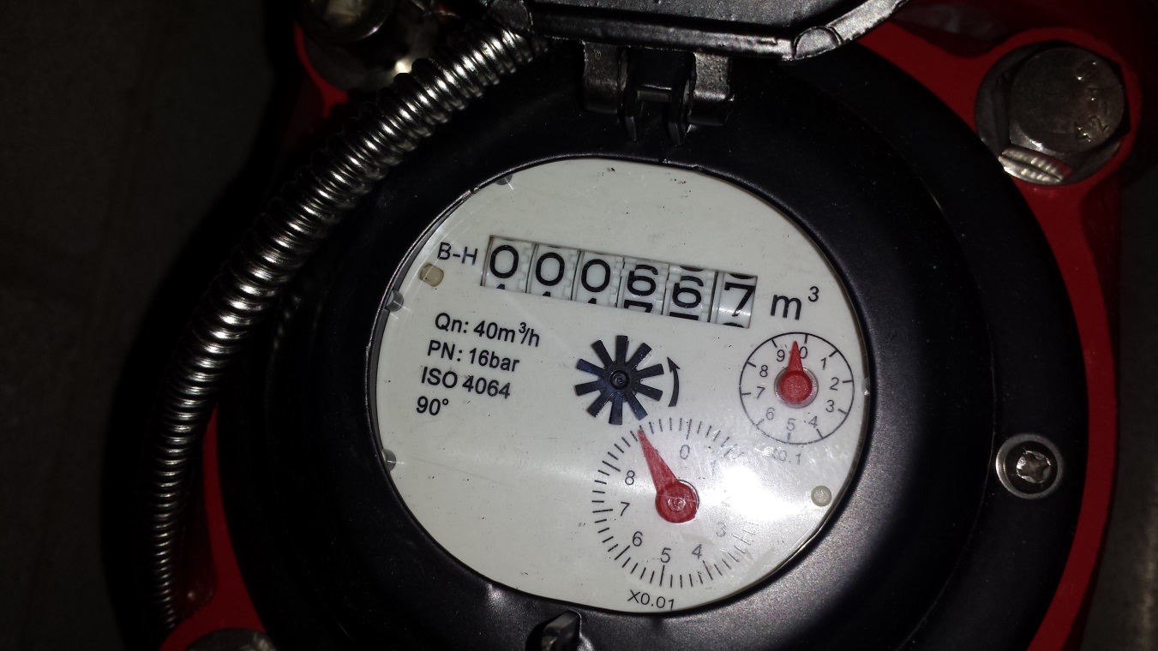
The Water Meter
Pulse meter that reads in hundreds of litres

Slide 4
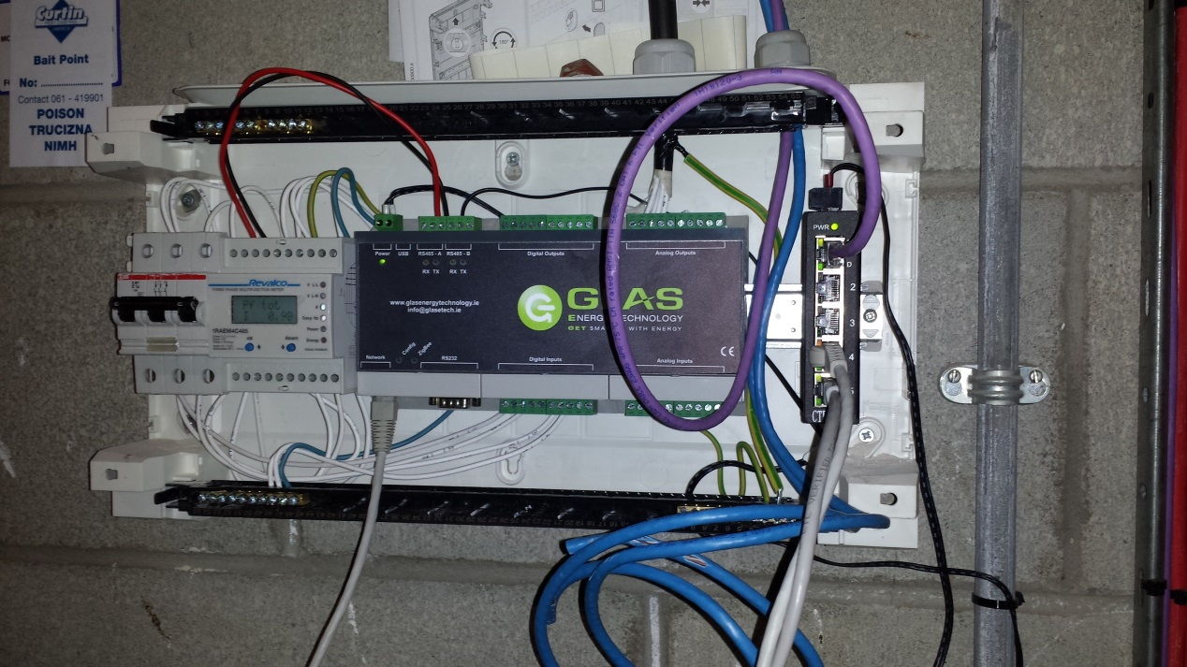
Data Logger
Reads electricity use from a smart meter in the college in kWhs
Reads water use via pulses from the water meter
Information is uploaded by FTP to a server on an hourly basis

Slide 5
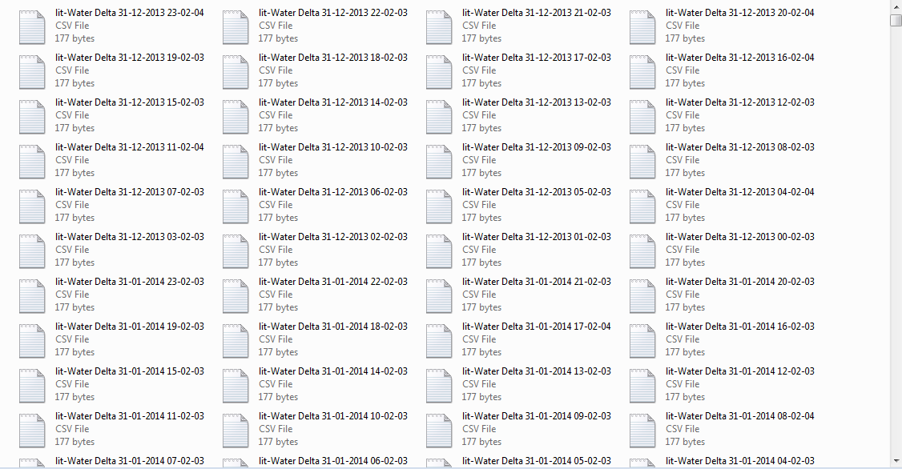
Raw Data

Slide 6
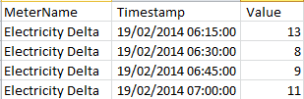
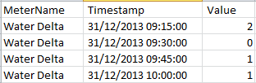
Water & Electricity Delta Files
Hourly files containing 15 minute intervals

Slide 7
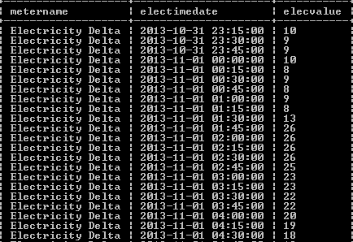
Database Data
Information parsed into database from raw files
Monthly files are created and archived (for auditing purposes)

Slide 8
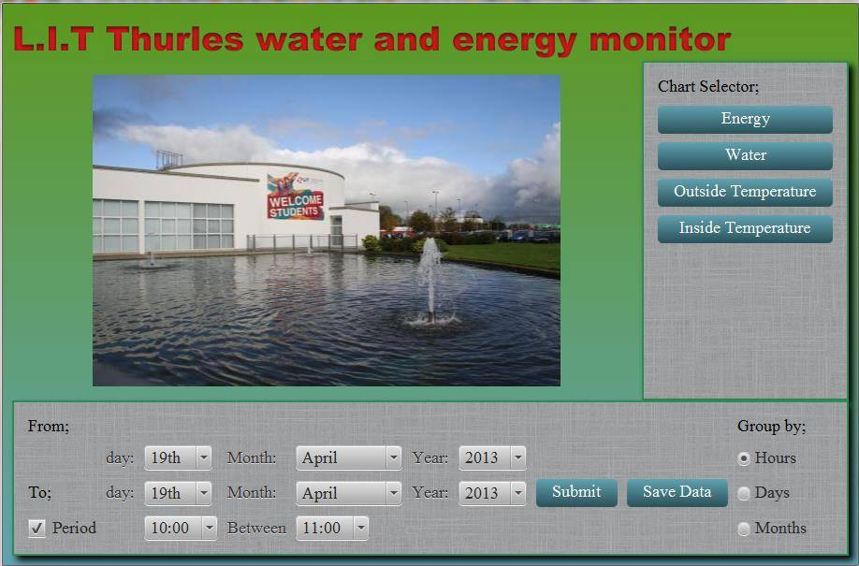
The GUI

Slide 9
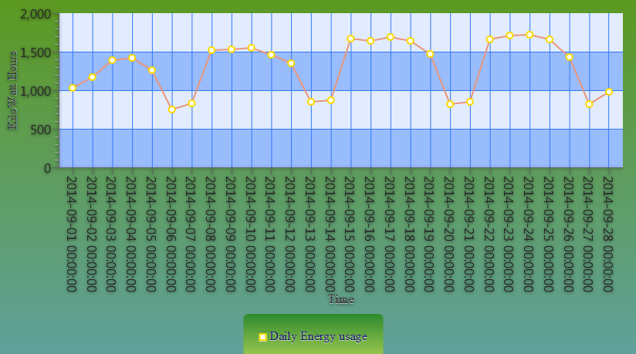
2014 Energy Usage
Variation of electricity usage throughout week
Less kWh used over weekends

Slide 10
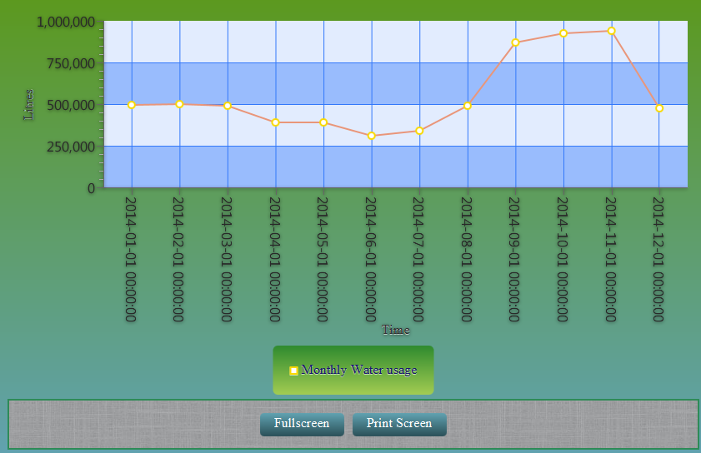
2014 Water Usage
Due to construction in 2014, large amounts of water were used over 4 months

Slide 11
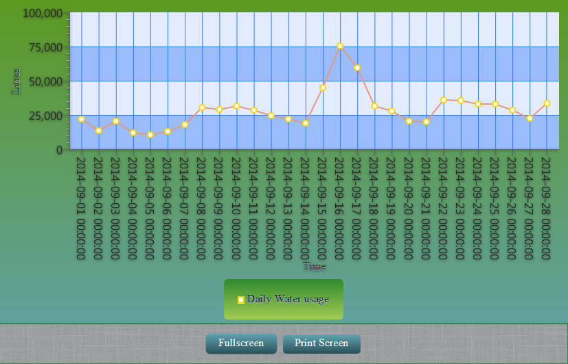
September 2014 Daily Water Usage
Application allows for large spikes to be identified as seen in the three day period above

Slide 12
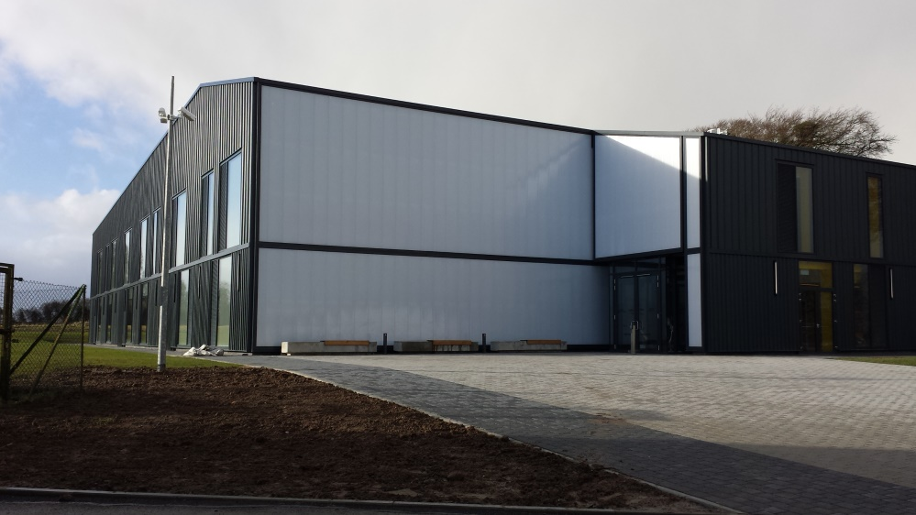
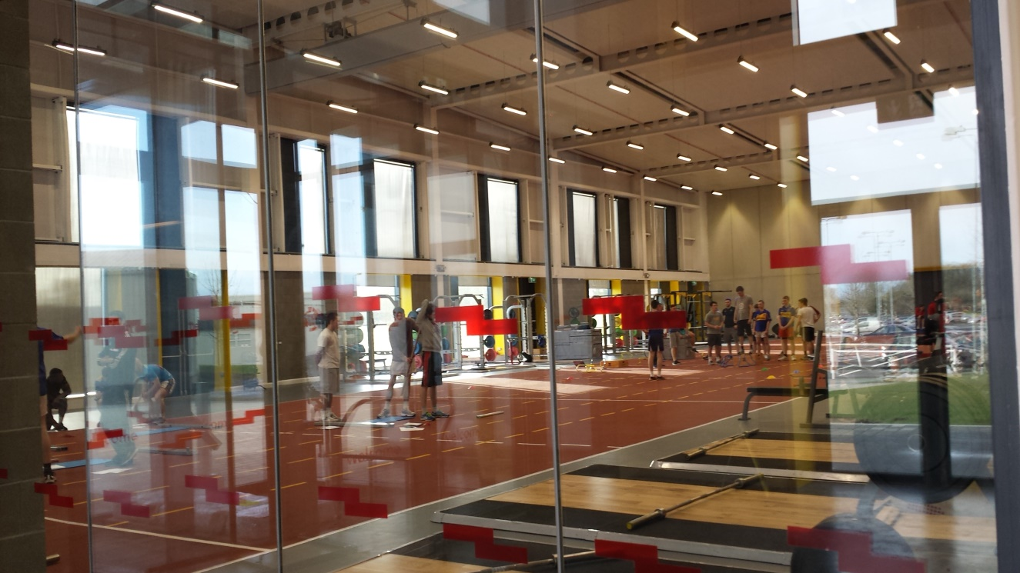

Slide 13
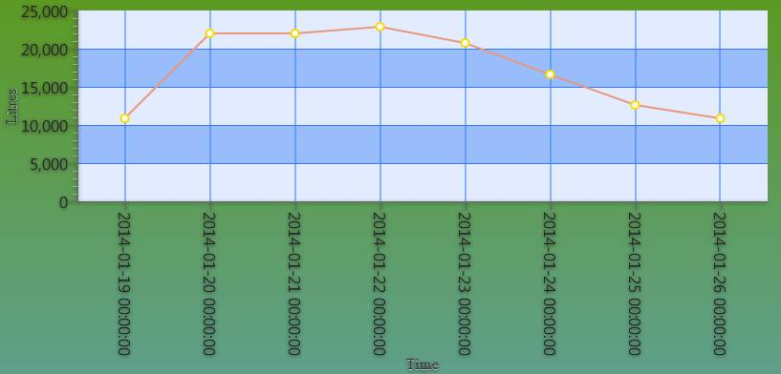
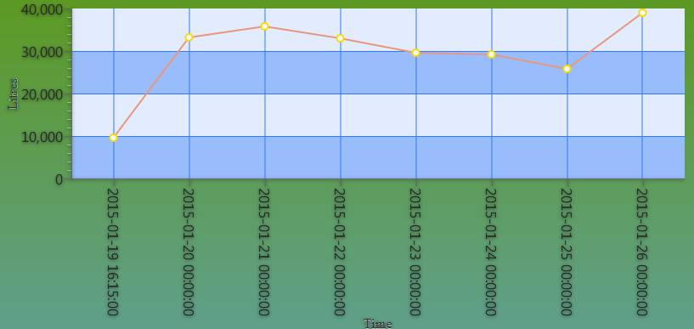
2014 January 19th-26th
2015 January 19th-26th

Slide 14
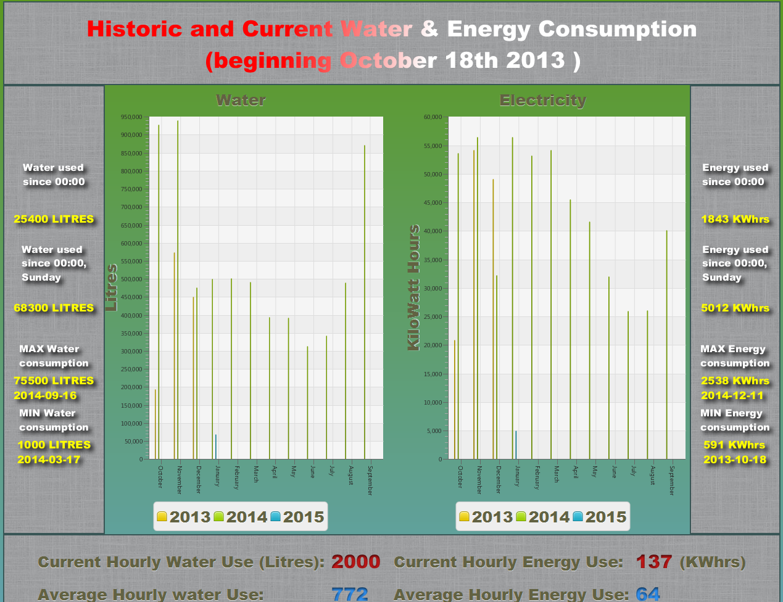
Persistent Monitoring App (On display outside The Canteen)

Slide 15
Future Work
As part of our 4th year project we are investigating how to integrate sensor data stored in the cloud with our system

Slide 16
Thank you
Any questions?

